Slide 1
Introduction to
Tandem Application Language
(TAL)

Slide 2
Introduction to TAL
High Level Language, Block Structured works efficiently with Tandem hardware to provide optimal performance.
Source program is compiled into executable object code which can run.

Slide 3
Uses of Tal
Systems Software – OS components, Compilers etc
Application software – Optimal performance Software, all up time software etc
Procedures that are callable from programs written in other language.

Slide 4
Features of TAL
Procedures
Subprocedures
Private Data Area
Bit Operations
Mixed-Language Programming
NonStop SQL Features
Also supports Pointers, Data Operations, Compiler Directives etc.
Modular programming
Notes:
Subprocedures—A procedure can contain subprocedures, callable only from
within the same procedure. When a subprocedure calls another subprocedure, the
caller’s environment remains in place. The operating system saves the location in
the caller to which control is to return when the called subprocedure terminates.

Slide 5
Data Types Description
STRING 8-bit ( 1 byte)
INT, INT(16) 16-bit ( 2 byte)
INT(32) 32-bit ( 4 byte)
FIXED, INT(64) 64-bit ( 8 byte)
REAL, REAL(32) 32-bit (4 byte)
REAL(64) 64-bit (8 byte)
UNSIGNED (n) where n bit field, 1<=n<=31

Slide 6
TAL Environment
A program is a static group of machine instructions and initialized data that reside in a file. The object executes as individual process on the tandem system.
The environment includes
Code space (user and Library )
Data space ( User and Extended )
System Code Space
System Library Space
Registers
Code
Library
Data
Environment

Slide 7
Code Space
Code Space
store the instructions in code
Upto 32 code segments
Each segment is 128KB
If object include library space then upto 16 code segments for library and 16 for code
If not then all 32 segments alloted to code.

Slide 8
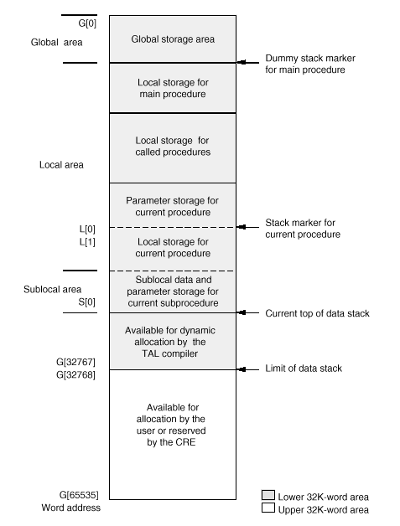
Data Space
User data segment
Maximum 128K
( 64K words)
The lower 32K used for global data and dynamic allocation of local data
Upper 32K accessed by pointer

Slide 9
DATA SPACE ( Contd)….
Any user defined data segment
Extended data segment provides a indirect storage in user data segment
.ext is how we declare the extended variables

Slide 10
REGISTERS
P – Contains the address of the next instruction in the code
L – contains the address of the start of the local data area
S – contains the address of the last allocated word in the stack

Slide 11
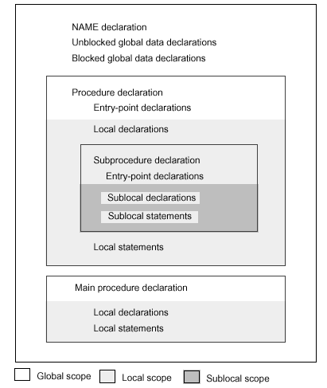
Structure of the Program
Name of the compilation unit
Unblocked global data
Blocked global data declarations
Proc declaration
Subproc declaration
Main proc declaration

Slide 12
Structure of the Program
NAME – Name of the compilation unit
Global Data – Data that can be accessed by all compilation units
All global declarations must appear before any proc declarations, except LITERAL & DEFINE
Block global declaration – Grouping of the variable and naming it with ‘BLOCK’ – ‘END BLOCK’ verb
The BLOCK declaration is used to group global data into named or private data blocks. Block can be shared within the various compilation units
PRIVATE’ block can be declared for that specific compilation unit
Procedure Declaration
Local declaration
Sub-local declaration

Slide 13
Structure of the Program
Name MYPROC;
Blocked Declaration
BLOCK ABC;
Int a;
Int b;
END BLOCK

Slide 14
Declaring Procedures
Sample procedure :
proc MYPROC;
Begin
Int a,b,c;
C := a +b;
End;
Forward Declarations : If you want to call a procedure before you declare the procedure body, then we declare it as FORWARD.
proc to_come; FORWARD;
External Declaration : If you want to call a procedure that is compiled in another compilation unit, then we declare the procedure as EXTERNAL.
proc in_another; EXTERNAL;

Slide 15
Constants, defines, Literals
CONSTANTS can be numbers or strings, and can be assigned to variables, declare as a literal. Various types of constants are
String Constants - “ABCDEFG”
Integer Constants – 255 ! Decimal base
%122 ! Octal Base
%B1010 ! Binary base
%H2F ! Hexadecimal base
Int( 32) +14769D………
Fixed point constants 1200.09F
Floting point constants 30.3E
DEFINE a named sequence of text
DEFINE diebold^atm^d = atdd1^core.term^typ = "30"#,
LITERAL a named constant
LITERAL true = -1,
false = 0,
chars = "AB";

Slide 16
Simple Variables
Variable is a symbolic representation of a item or a group of elements. The value of the variables can change during the program execution.
INT num;
INT num1,
num2;
INT var := 5;
INT chars := "AB";
STRING a := “XYZ”;
STRING b := 123;
INT(32) n := 100D;
INT(32) ch := “IJKL”;
REAL r := 0.6E0;
REAL(64) r1 : = 0.576383L1;
FIXED f := 300.089F;

Slide 17
Sample Program
NAME MYFIRST; - name declaration
INT TOTAL; - global data declaration
BLOCK shared; - Named data blocks
Int a;
Int b;
END BLOCK;
PROC my_proc; - Procedure heading
BEGIN
total := a + b; - Procedure Body
END;

Slide 18
ENTRY POINTS
A procedure entry point is an identifier by which callers can call a procedure.
Secondary entry points are entry-point identifiers declared within the procedure and then placed at statements where the procedure can begin executing.
PROC myproc (param); !Declare the procedure
INT param;
BEGIN
ENTRY entry1; !Declare entry-point identifier
INT var;
!Some code here
entry1: !Apply entry-point
var := var - param; ! identifier to statement
!More code
END;
An example of entry point in base24 is the proc get^iso^crncy^cntry^cdes in bautils,which is being called by the various callers directly by calling the entry points like get^iso^dec^places( N50S), get^iso^cntry^data, get^iso^crncy^cde^alpha, crncy^dec^places^alpha, conv^cntry^cde

Slide 19
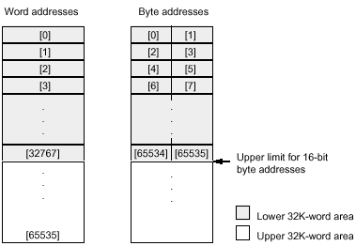
Addressing Modes
Direct Addressing
The entire 128K user data area is word addressable, however the lower 64K is byte addressable with 16 bit pointers.
Address conversion can be performed using an unsigned (‘<<‘ or ‘>>’) shift.
INT A := 300;
A
300

Slide 20
Addressing Modes
Indirect Addressing
Requires two memory references
First to location that contains an address in primary storage
Next to data located at the address in secondary storage
To save space in limited storage areas
INT .A := 8;
Value
Data Type
Identifier
Indirection Symbol

Slide 21
Addressing Modes
Byte Add
Word Add
Indirect Addressing
Example
INT .A[0:1]; ! Initialize A
INT .B; ! Initialize B
A[0] := 8; ! Assign to A
A[1] := 9;
B := 10; ! Assign to B
GLOBAL MAP
A INT G+ 001 INDIRECT
B INT G + 002 INDIRECT
G+0
G+0
G+2
200
A
G+1
Implicit Pointer
G+4
204
B
G+2
Primary Storage Area
200
8
9
10
Secondary Storage Area
204

Slide 22
Addressing Modes
Standard Indirect Addressing
Byte or word addresses in the lower 32K word area
Word addresses in the upper 32K word area
Extended Indirect Addressing
32-bit relocatable indirect addressing anywhere in the virtual memory / Extended data segment
INT .EXT A := 8;
Primary Storage Area
A
200
Data type
Implicit Extended Pointer
Ext Indirection Symbol
200
8
Ext. Data Segment / Virtual Memory

Slide 23
Arrays
STRING a_array[0:2] ; ! Three-element array
Data type
Identifier
Lower bound
Upper bound
STRING .a_array[0:2] ; !Std. Ind. Addressing
STRING .EXT a_array[0:2] ; ! Ext. Ind. Addressing

Slide 24
Arrays
Array Declaration & Initialization
INT(32) .a[0:1] := [5D, 7D];
STRING .b[0:1] := ["A","B"];
INT d[0:2] := ["Hello!"]; ! Stores 1 character per byte
FIXED .EXT c[0:3];
REAL(64) r[0:1];
INT some_array[0:3] := -1; !Partially undefined
INT ZEROES [0:9] := 10 *[0]; ! Initialised to 0 with a repitition factor of 10.

Slide 25
Arrays
Sublocal arrays cannot be indirectly addressed, Since there is no secondary local storage area
Indirect allocation of arrays as same as simple variables

Slide 26
Arrays
Concatenating operator – ‘&’
line_array ':=‘ " DATE: “ date_array FOR date_len BYTES
& " ID NUMBER: " & id_num FOR id_len BYTES
& " DEPARTMENT: " & dept_num FOR dept_len BYTES;
Scanning array
The SCAN statement scans the array from left to right while the RSCAN scans the array from right to left
Eg
start_last_name contains the string “Hello, how are you”
SCAN sptr[0] WHILE " " -> @start_last_name;
SCAN start_last_name UNTIL "," -> @comma;

Slide 27
Structures
Occurrences
STRUCT .Stu^Details [0:2];
BEGIN
STRING Stu^Name [0:40];
INT Stu^Number ;
END;
Name of the structure
Indirection Symbol
Body of the structure
Stu^Details
2000
Primary Storage
Stu^Name[0:40]
2000
Stu^Details(0)
Stu^Number
Stu^Details(1)
Secondary Storage

Slide 28
Structures
Direct structures are stored in primary storage area
Indirect structures are stored in the secondary storage as like variables/array
Nested Structures (Structure within structure) are allowed upto 64 levels
Cannot initialize a structure item when you declare
Compiler starts the allocation of each structure occurrence on a word boundary

Slide 29
Template Structure
Declaring a structure without allocating storage
It can be referred by other structures
STRUCT stock (*);
BEGIN
INT item;
FIXED(2) price;
INT quantity;
END;
Template Structure Identifier

Slide 30
Referral Structure
Allocates storage for a structure whose layout is already declared
STRUCT .stocks^ref (stock) [0:40];
Referral
Occurrences
Template
Keyword
Indirection Symbol

Slide 31
Substructure
Structure embedded with another structure or substructure
Can be nested upto 64 levels
Referral structures are allowed
They have byte addresses not word addresses
Struct .A;
Begin
...........
...........
Struct B;
Begin
.............
.............
End;
..............
End;

Slide 32
MULTIDIMENSIONAL structure
LITERAL last = 49; !Declare number of last item
STRUCT .warehouse[0:1]; !Declare structure WAREHOUSE
BEGIN
STRUCT inventory[0:last]; !Declare substructure
BEGIN ! INVENTORY
INT item_number;
INT price;
INT on_hand;
END; !End INVENTORY
STRUCT employee[0:9]; !Declare substructure
BEGIN ! EMPLOYEE
STRING name[0:31];
STRING telephone[0:6];
END; !End EMPLOYEE
END; !End WAREHOUSE

Slide 33
Structure Pointer
Can declare structure pointers within a structure or substructure
Stores the memory address of a structure.
.EXT to store 32 bit address (extended)
. to store 16 bit address (standard)

Slide 34
Redefinitions in Structure
New description for a previously declared item in the same structure
New item must be at the same Begin-End level
New item must also be of the same or shorter in length than the previous item.
STRUCT simple_variable_redefinition;
BEGIN
INT old_var;
STRING new_var = old_var;
END;
INT
String
old_var
new_var

Slide 35
Redefinitions in Structure
Substructure, Template structure and Referral structure are also allows redefinition

Slide 36
Accessing Structure Items
STRUCT .struct_b;
BEGIN
STRUCT sub_1;
BEGIN
STRUCT sub_2;
BEGIN
STRUCT sub_3;
BEGIN
INT a;
INT b;
INT item_x;
END; !End SUB_3
END; !End SUB_2
END; !End SUB_1
END; !End STRUCT_A
struct_b.sub_1.sub_2.sub_3.item_x

Slide 37
POINTERS
Pointers are variables in which you store the memory address of the variables.
Simple pointer
INT .my_ptr; ! Simple pointer
INT .EXT my_xptr; ! Extended simple pointer
Initializing a simple variable pointer
STRING .array[0:3]; !Declare ARRAY
STRING .string_ptr := @array[3]; !Declare STRING_PTR; initialize
! it with address of ARRAY[3]
STRING simple pointer for byte access to a word-addressed array
INT .word_array[0:39]; !Declare WORD_ARRAY
STRING .byte_ptr := @word_array[0] '<<' 1; !Declare BYTE_PTR; initialize
! it with converted byte
! address of WORD_ARRAY
INT simple pointer for word access to a byte-addressed array
STRING .byte_array[0:4]; !Declare BYTE_ARRAY
INT .word_ptr := @byte_array[0] '>>' 1; !Declare WORD_PTR; initialize it with converted word
! address of BYTE_ARRAY

Slide 38
POINTERS
Structured Pointer
INT .struct_ptr (prev_struct);
INT .EXT xstruct_ptr (prev_struct);
Initializing structure pointer
STRUCT struct_a[0:2]; !Declare STRUCT_A
BEGIN
INT var;
END;
INT .struct_ptr (struct_a) := @struct_a[1];

Slide 39
Procedures
To perform specific task
Callable from anywhere in the program
A program can contain one or more procedure
MAIN procedure is must
Procedure can have
Statements , Data Declarations
Subprocedures

Slide 40
Subprocedures
A procedure can have number of Subprocedures
Only accessible from that procedure alone
Subprocedure cannot have another Subprocedure
‘CALL’ verb is used to execute Procedure / Subprocedure

Slide 41
Procedures - Declaration
Identifier
Procedure attributes, if any
PROC my_proc (param) MAIN ;
INT param;
Key Word
Identifiers of formal Parameters
Parameter Data type
Parameter Identifiers

Slide 42
Procedures - Examples
! This is a simple procedure without any parameters
PROC my_proc ;
BEGIN
INT var1;
INT var2;
x := var1 - var2;
END;
(x)
! Procedure definition
! Begin of the proc statements
! Proc variables
! Proc statements
! End of the proc statements
INT x;
! Parameter declaration

Slide 43
Program flow control
IF – Conditionally selects one of the two possible flow
IF ( a = b ) then
begin
……
end
ELSE IF ( a = c ) then - OPTIONAL
begin
…..
end
ELSE - OPTIONAL
begin
….
end;

Slide 44
Program flow control
CASE – select one of several expressions
CASE a of
BEGIN
1 -> do something;
2 -> do something else;
3,4 -> do something else;
otherwise -> forget it;
END;

Slide 45
Program flow control
WHILE – executes the loop while the condition is true
DO – executes the loop while the condition is true
int a = 0, x = 16;
WHILE ( a < 3 ) DO
BEGIN
X := x + 1;
A := a + 1;
END;

Slide 46
Program flow control
FOR – executes the loop for n times
FOR I := 0 to 4 DO ( increment I )
FOR I := 10 DOWNTO 0 DO ( decrement I)
CALL – calls another procedure
CALL other_proc;
RETURN – returns the control back to the caller
RETURN error;

Slide 47
Program flow control
GOTO – sends the control to the space specified within procedure/subprocedure
PROC TEST;
BEGIN
LABEL L1;
INT A, B:= 3;
L1:
a := b*3;
some code …..
goto L1;
END;

Slide 48
Compiling TAL program
TACL> TAL/in <input source name>, <options>/< output object name>; Compiler directives
TACL> TAL/ in mysource, cpu 1, pri 120/ myobj; symbols

Slide 49
Practicals
Welcome to TAL
Write a program to accept you name and print it back
Write a program to ask for 2 numbers and the operator and show the result based on the operation specified
Write a program to do a add, update, delete and view into a file ( using ddl )

Slide 50
Thank you

